Slide 1

Voltage Mode Control of Buck Converter
Presented by-
Guided by-
Dr. Amit Kumar Singha
Rahul Yadav
(B20059)

Slide 2
Design a DC-DC converter with the following specifications: Vin=8 V, Vo=3.3 V, Po=20 W Choose a switching frequency and Design L & C. Find the part no's of L and C Choose a suitable MOSFET/diode and driver (provide part no.) Derive and plot the small signal model of the converter if voltage mode control is employed. Make suitable assumptions if required

Slide 3
Assumptions
Switching frequency is considered as 100kHz.
Ripple in inductor current is 20% of load current.
Ripple in capacitor voltage is 1% of load voltage.

Slide 4
Voltage Mode Control of Buck Converter

Slide 5

Calculation of L&C
$L=\frac{\left(Vin−V0\right)D}{f×∆I}=\frac{(8−3.3)×0.4125}{100×{10}^{3}×0.2×6.06}=15.96μH$
$C=\frac{\left(Vin−V0\right)D}{8×f^{2}×L×∆V}=\frac{(8−3.3)×0.4125}{8×{(100×{10}^{3})}^{2}×15.96×{10}^{−6}×0.01×3.3}=46.013μF$

Slide 6


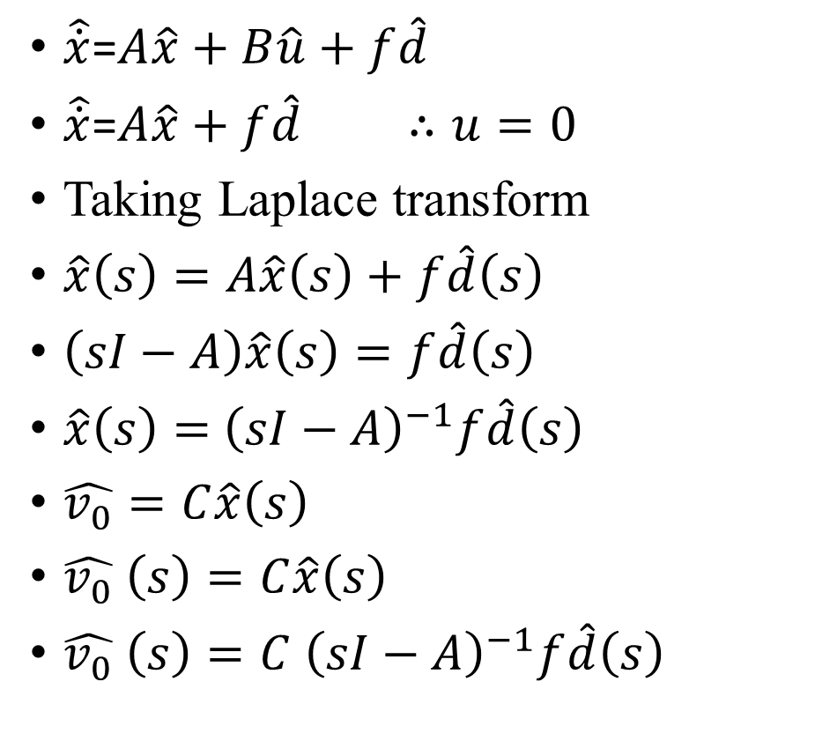

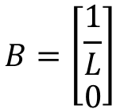

Small Signal Model of Buck Converter
$\hat{\dot{x}}$=$A\hat{x}+B\hat{u}+f\hat{d}$
$\hat{\dot{x}}$=$A\hat{x}+f\hat{d}$ $∴u=0$
Taking Laplace transform
$\hat{x}\left(s\right)=A\hat{x}\left(s\right)+f\hat{d}\left(s\right)$
$\left(sI−A\right)\hat{x}\left(s\right)=f\hat{d}\left(s\right)$
$\hat{x}\left(s\right)=$ ${\left(sI−A\right)}^{−1}f\hat{d}\left(s\right)$
$\hat{v_{0}}=C\hat{x}\left(s\right)$
$\hat{v_{0}} \left(s\right)=C\hat{x}\left(s\right)$
$\hat{v_{0}} \left(s\right)=C$ ${\left(sI−A\right)}^{−1}f\hat{d}\left(s\right)$
$$\left[\begin{matrix}0 & \frac{−1}{L} \\ \frac{1}{C} & \frac{−1}{RC}\end{matrix}\right]$$
$$B=\left[\begin{matrix}\frac{1}{L} \\ 0\end{matrix}\right]$$
$A =$
$$C=\left[\begin{matrix}0 & 1\end{matrix}\right]$$
$$\frac{\hat{v_{0}} \left(s\right)}{\hat{d}(s)}=\frac{\frac{Vin}{LC}}{s^{2}+\frac{S}{RC}+\frac{1}{LC}}$$

Slide 7
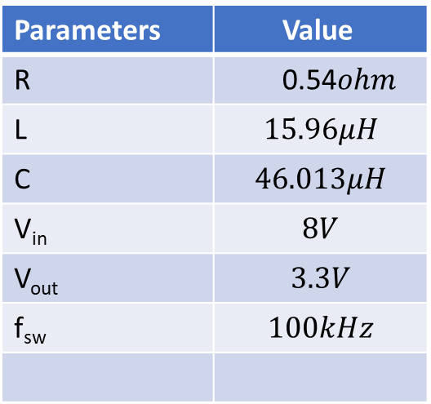
Bode Plot
Parameters | Value
R | 0.54$ohm$
L | $$15.96μH$$
C | $$46.013μH$$
V_{in} | $$8V$$
V_{out} | $$3.3V$$
f_{sw} | $$100kHz$$
Ki=707.81
Kp=1.627

Slide 8
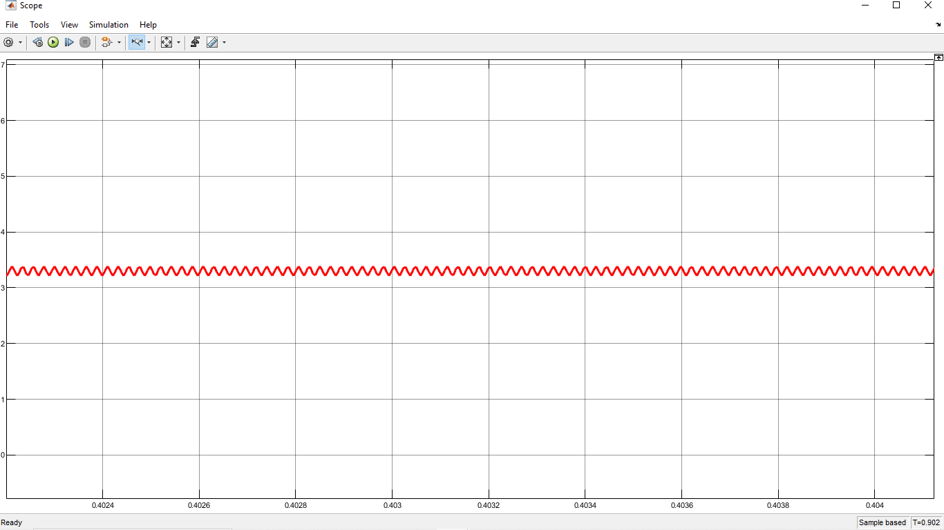
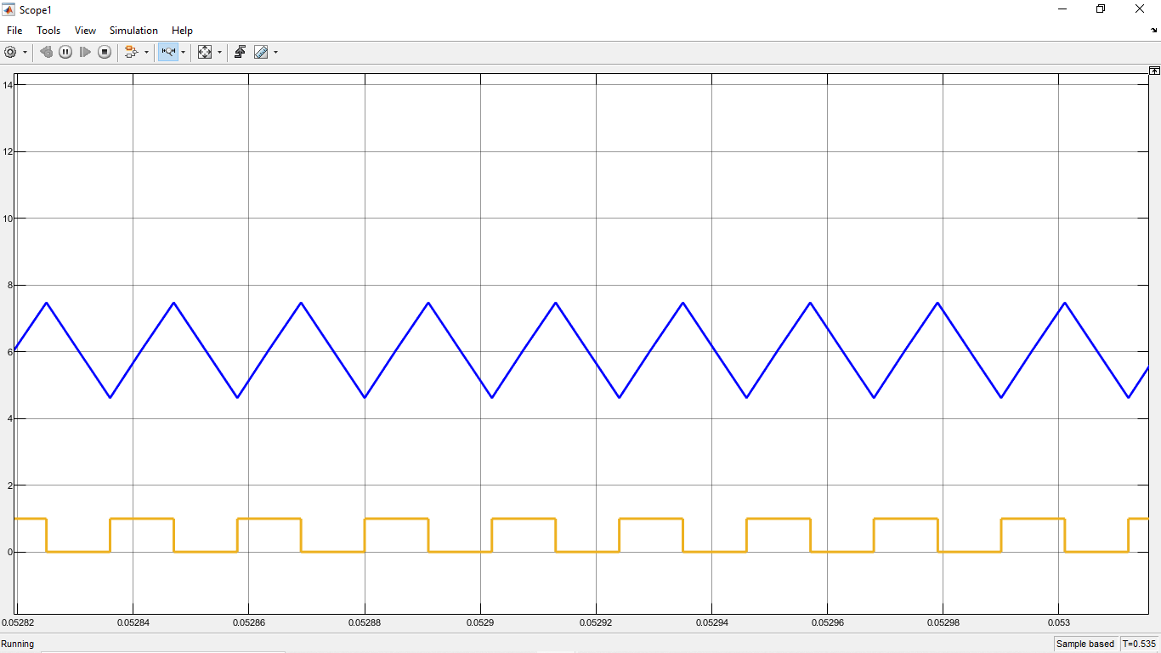
Capacitor Voltage & Inductor Current
Fig2. Output voltage and Inductor current

Slide 9
Part numbers
For Practical application, Multiplying with a non-ideality factor of 2 we will get L=31uH and C=100uF.
Part Number of L - HCTI-56-10.2
Part Number of C - Aliases (C1206C107M9PAC7800) {Ceramic capacitor for lower ESR}.
MOSFET- SiRA14DP
Diode- MBR2030CTLG
Gate Driver-ZXGD3002E6

Slide 10
THANK YOU

